Slide 1
Corporate Insolvency Law Week 1
Akshaya Kamalnath

Slide 2
Introduction Aims of insolvency Theories Rescue versus liquidation

Slide 3
What is insolvency? What is insolvency law?

Slide 4
Course description
This course will examine the basic concepts and principles informing corporate insolvency regimes to identify and evaluate the incentives embedded in them and the goals sought to be achieved. Perspectives from other jurisdictions will be used, where relevant, to evaluate corporate insolvency processes and outcomes.
Topics to be discussed include:
Theories and goals of corporate insolvency
Rescue versus liquidation
Incentives to initiate corporate insolvency processes
Director liability
Insolvency professionals

Slide 5
Course aims
1.Investigate and critically evaluate corporate insolvency theories and principles.
2.Reflect critically on corporate insolvency processes.
3.Explore and review developing issues and debates with respect to corporate insolvency and the management of corporate assets (for example cryptocurrencies).
4.Critically analyse and assess complex information at a theoretical level to develop understanding of and problem solving skills with respect to corporate insolvency and communicate solutions to a variety of audiences.
5.Plan and conduct legal research on practical and policy questions relating to corporate insolvency.

Slide 6
Assessment 1
This task requires you to reflect on one of the following topics: (i) Rescue versus liquidation – which do you favour and why? (ii) What are content and purpose of the duties of director in the zone of insolvency?; (iii) What are the aims of insolvency law?
Assessment Criteria:
Understanding of and reflection about the material taught in the course;
Ability to make connections across the materials;
Clarity and conciseness; and
Expression.
Due date: 15 March 2022, 5 PM.
Posts must be submitted to both Turnitin and the dedicated assessment discussion forum.
Word Limit: 1,800
Importance of argument (Refer rubric)

Slide 7
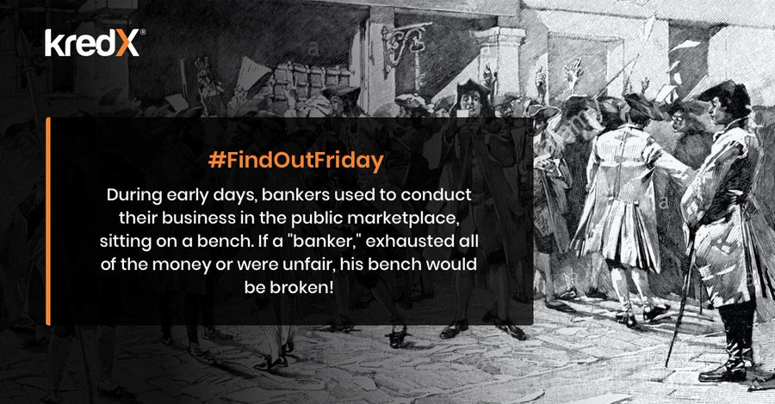


What is insolvency?
Terminology:
Insolvency: 1650s, "able to pay all one owes," from French solvent, from Latin solventem (nominative solvens). [Etymology]
Bankruptcy: "in the state of one unable to pay just debts or meet obligations," 1560s, from Italian banca rotta, literally "a broken bench," from banca "moneylender's shop," literally "bench" (see bank (n.1)) + rotta "broken, defeated, interrupted" from (and in English remodeled on) Latin rupta, fem. past participle of rumpere "to break" (see rupture (n.)). Said to have been so called from an old custom of breaking the bench of bankrupts, but the allusion probably is figurative.

Slide 8
Insolvency/ bankruptcy stigma
Australia: On bankruptcy stigma
https://www.unswlawjournal.unsw.edu.au/wp-content/uploads/2017/09/38-4-1.pdf (Ali, O’Brian, Ramsay)
Outside Australia:
“…the fear of the failure and the stigma on failure are very common in Germany as well as the fear of financial ruin. This is one of the reasons why people in Germany tend to be risk averse, because they see the financial and social costs of failure as outweighing the benefits of success. These factors negatively influence entrepreneurship in Germany.” (https://www.iiiglobal.org/sites/default/files/report_germ.pdf)
See Paul Omar’s chapter on what caused stigma and how it slowly abated.
From fallimento (failure) to rescue (fresh start)

Slide 9
Insolvency/ bankruptcy stigma
From the chapter by Paul Omar:
“The beginnings of the process of depenalisation/decriminalisation of insolvency may also have resulted from the gradual acceptance of limited liability as the standard and the realisation that insolvency was an unavoidable risk of trade. The fact that insolvency became an inevitable corollary to commercial life may have done much to lessen the stigma attached to it, as witness early attempts to mitigate some of the penalties in the Bankruptcy Acts 1883 and 1914 (United Kingdom). It remains the case, however, that even today, insolvency law has not fully shaken off the associations of stigma and fault…” [Pp 5 – 6]

Slide 10

Walt Disney
“Despite early popularity, the studio’s rapid employment of animators was too much for the business to sustain. Eventually, immense debt forced the company into bankruptcy and left Disney penniless. However, these events were to change the face of movie studios forever.
Joining forces with his brother, Disney left for Hollywood, hoping that the industrial heartland of movies would provide a better backdrop for his ambitions. Together, the pair formed the Disney Brothers Cartoon Studio in 1923. And today, revenue-wise Disney’s company is the biggest media conglomerate in America.”
https://www.top-business-degrees.net/10-millionaire-entrepreneurs-who-bounced-back-from-bankruptcy/

Slide 11

Colonel Sanders
“It was in 1967, at the age of 65, that the Colonel found himself broke, partly due to the construction of a road that put him out of business. He wound up living in his car and driving to over 1,000 restaurants trying to sell his chicken recipe, asking a nickel commission on each chicken.”
“After KFC went from a single cafe to a franchised concept, Sanders sold the business in 1964, feeling out of his league at the age of 75 as the chain rapidly grew.”
https://realbusiness.co.uk/6-entrepreneurs-who-failed-spectacularly-before-succeeding
https://www.entrepreneur.com/article/250300

Slide 12
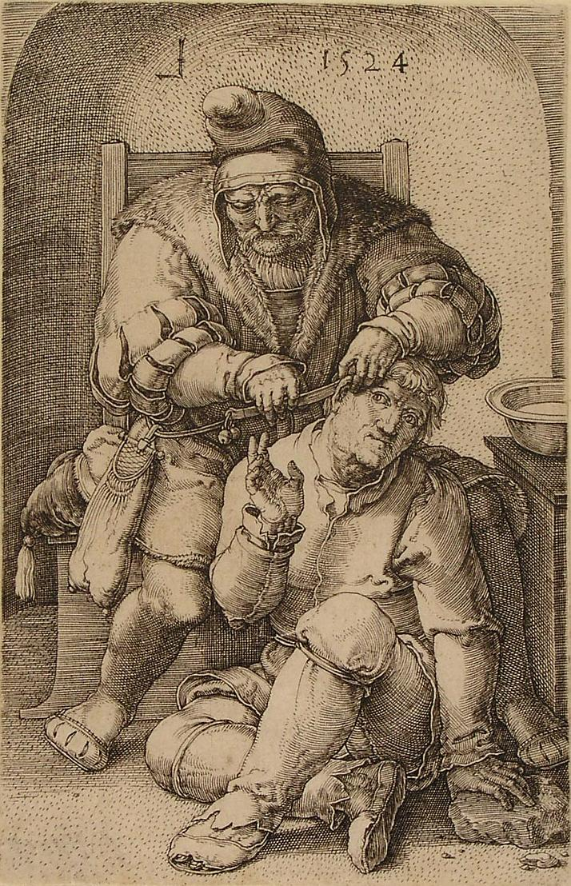
“Rescue” since the early days
What does “pari passu’ mean?
What else did it involve?
Standstill
Haircut
Trading during rescue
19th century – focus on liquidation
20th century – rescue begins to take shape (France? China? South Africa?)
U.S. Chapter 11 – debtor in possession
Practitioner-in-possession
Many developments recently – so does rescue mean very different things?

Slide 13
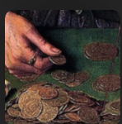
Goals and theories of insolvency law
One view: Transparency (in the enforcement process); Predictability; Efficiency (needs and rights of both creditors and debtors)
Other views?
What are the theories saying?
Prof Tony Casey’s emphasis on the role of the judiciary in insolvency law.
Justice Kannan Ramesh on the role of the court in insolvency cases: https://open.spotify.com/episode/57rYvofIgPkj3oePT6ByxP?si=ac942208c5c74333 [8.07 – 10.06]
Is there a role for the state? International bodies?
Other institutions - professionals? (Refer to the introduction in the book by Westbrook et.al.)

Slide 14
Feminist perspective in insolvency theory?
See assigned article by Jacobs.
Contractarian theories (of which CB is one) versus communitarian/ stakeholderist theories.
See also my (co-authored) article, Adding mediation to India's corporate resolution process (specifically part 4 which looks at insolvency law from a feminist lens).

Slide 15
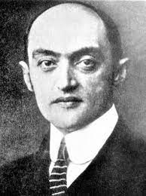
Goals and theories of insolvency law
“For what purpose?” versus “For whom?”
Prof Christoph Paulus: For the economy [https://open.spotify.com/episode/6OwGJ8QHqQI1DMbELAv4mr?si=7f732481bb214f6d Listen from 10.03 – 12.12]
Joseph Schumpeter saw bankruptcy as the obsolescence of some industries as part of the cycle of the economy whose growth had benefitted millions of people. [See Schumpeter’s Capitalism, Socialism and Democracy Pp 81 - 86]

Slide 16
State-led creative destruction and strategies to deal with zombie companies
Listen to this interview with Professor Parry: https://open.spotify.com/episode/2fDfKcIhBzl000dkjkNflb?si=253faf94f3b94326 [Listen up to 27.00]
Things to pay attention to –
1. What makes an insolvency legislation work?
2. Following from that, why does the state need to engineer creative destruction?
3. Role of the courts.

Slide 17
Week 2 Podcast
Rescue finance
Various types of rescue
Clarification about a reading for week 2: The idea of rescue in Chapter 11 – see Chapter 4 of the book that the link takes you to.

